Slide 1
MediLocate
Adriana Carolina Garcia Serrano (200535537)
Week ?
Month Date, Year
Software Engineering Management (ENSE 374)

Slide 2
Agenda
Introduction
Problem Definition
Design Requirements
Solutions
Project Management
Conclusion and Future Work

Slide 3
Introduction
MediLocate is a web-based application designed to streamline how Canadians book medical appointments, addressing common frustrations like long wait times and communication barriers. Traditional appointment booking methods are often inefficient, leaving patients frustrated and clinics overwhelmed. MediLocate offers a user-friendly platform for patients to easily schedule appointments and for medical staff to manage their availability.
The rationale for this project stems from the urgent need to modernize healthcare access. With the rise of digital solutions, there’s a clear demand for a platform that simplifies the booking process while maintaining flexibility and reliability for both patients and healthcare providers. MediLocate’s design aims to fill this gap by providing a seamless and accessible solution.

Slide 4
Problem Definition
Canada’s healthcare system struggles with accessibility. With only 2.6 physicians per 1,000 people, the demand for medical services far outstrips the supply. Nearly 30% of Canadians report trouble accessing care, and 20% of patients experience delays of over a week just to see a family doctor. This imbalance frustrates patients and sometimes prevents them from receiving critical care.
The impact is widespread:
Patients’ Health: Delayed care can worsen medical conditions, increase anxiety, and lower quality of life.
Rural Disparities: People in remote areas face even more obstacles, with fewer healthcare facilities and long travel times.
Clinic Operations: Manual appointment scheduling adds administrative strain, increases errors, and reduces efficiency.
Provider Burnout: Overloaded clinics struggle to manage patient flow, often leading to staff burnout and declining care quality.
Without an efficient system, patients and providers both suffer from mismanaged resources and unmet needs.

Slide 5
Design Requirements
Primary Goal:Develop a user-friendly web application to help users locate doctors and schedule appointments efficiently.Secondary Goals:Ensure seamless user experience for both patients and medical staff.Enable real-time updates for appointment changes.Provide a secure login system for patients and medical staff.Use MVC architecture for maintainability and scalability
ObjectivesFor Patients:
Allow patients to search for doctors based on specialization, location, or availability.Let patients book, reschedule, or cancel appointments easily.Display relevant doctor information (e.g., expertise, ratings).
For Medical Staff:
Enable medical staff to manage their availability.Provide tools to update appointment statuses in real-time.General Functionality:Implement a login and user role management system.Design a database with multiple table relationships to handle user data, schedules, and doctor profiles.Use stored procedures to optimize database queries.UI/UX Goals:Make the interface clean, responsive, and intuitive.Use visual cues for real-time updates (e.g., notification banners or updated schedules).Testing and Deployment:Conduct thorough testing for user roles, database interactions, and edge cases.Deploy the app on a hosting service for accessibility.

Slide 6
Constraints
Technical Constraints:
Must use ASP.NET Web Forms for the application.
Database operations should be performed using stored procedures.
Incorporate an MVC architecture.
Time Constraint:
The project must be completed by November 20.
Team Constraint:
As the project lead, you are responsible for completing most of the work due to limited team participation.
Budgetary Constraint:
There is no budget allocated for features like a payment system.
Feature Constraints:
Real-time updates for scheduling must be functional.
The app does not require advanced features like integration with external APIs or payment systems.

Slide 7
Solutions
Solution 1
Our initial solution was a basic platform allowing patients to search for clinics by specialty and location and view the services offered by each clinic. This system aimed to provide patients with a centralized place to access clinic information.
Reasons for Not Selecting: While the idea improved access to clinic details, it lacked essential features for an effective healthcare platform:
Booking Functionality: Patients could view clinic information but had no option to book appointments directly, requiring them to contact clinics manually.
Dynamic Scheduling Options: Clinics could not adjust service flexibly to reflect changes.
These limitations hindered the platform from addressing the full needs of both patients and providers, leading us to develop a more comprehensive solution.
Without these features, the solution wouldn't provide the full value needed for a seamless healthcare

Slide 8
Solution 2
The second solution improved upon the first by integrating an interactive map using the Google Maps API, displaying clinics near a user's location. This approach provided a more intuitive and visual way for patients to find and book appointments with local clinics, offering details like addresses, operating hours, and available services. Additionally, we planned accessibility features such as text-to-speech for visually impaired users.
Challenges:
Integrating Google Maps with real-time scheduling data was complex and could create maintenance challenges.
Development time for accessibility features would require additional resources and testing.
This solution addressed usability and accessibility, but the technical complexities and additional time needed for accessibility features meant it wasn't quite the best fit for the project at this stage.

Slide 9
Final Solution
Solution Overview: This final solution incorporates the most critical features to enhance the user experience for both patients and healthcare providers. It combines a robust appointment scheduling system, the ability for patients to easily find the right healthcare professional, and upfront visibility into the costs of medical services. It also focuses on simplifying appointment management for medical professionals to help them gain more patients and keep their schedules organized.
Why this solution is better:
This solution addresses the business needs identified in the case by enabling both patients and healthcare providers to efficiently book and manage appointments. By offering transparent service pricing, and simplifying the process of finding medical professionals, it helps build trust and ensures a smooth experience for all users.

Slide 10
Feature | Description
User Roles and Login | Allows patients and medical staff to access customized features based on their roles.
Clinic Search and Filtering | Enables users to search for clinics by specialty, location, or other filters.
Appointment Management | Patients can book, reschedule, and cancel appointments, while medical staff can update availability and manage schedules.
Real-Time Updates | Provides instant notifications about schedule changes, confirmations, and reminders.
Responsive Design | Optimized for desktop, tablet, and mobile devices to ensure accessibility for all users.
Secure Authentication | Implements OAuth 2.0 and secure data transfer protocols to protect user information.
Schedule Flexibility | Clinics can update availability on a daily, weekly, or monthly basis to meet operational needs.
Comprehensive Clinic Profiles | Displays clinic details, including services offered, contact information, and available appointment slots.

Slide 11
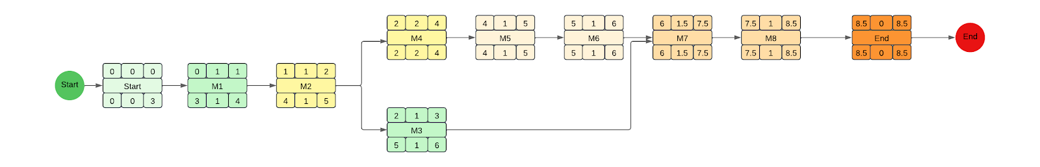
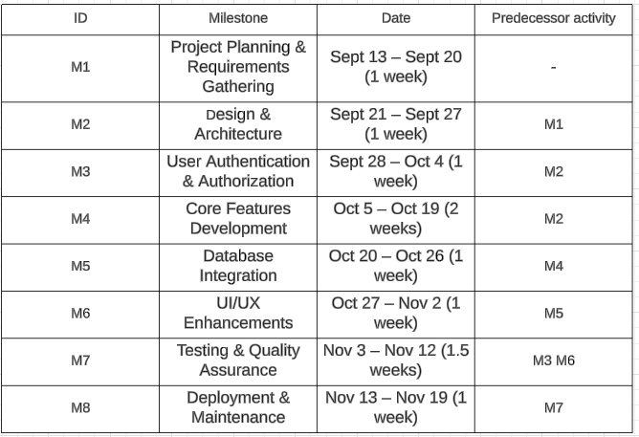
Project Management
Activity diagram:

Slide 12
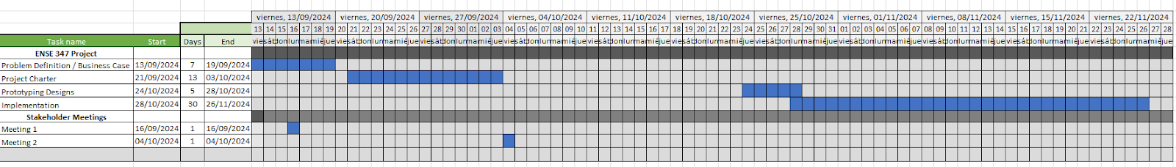
Gantt diagram

Slide 13
Conclusion and Future Work
Recommendations for Future Design Improvements
Authentication for Medical Professionals: Future versions of the system should incorporate proper authentication mechanisms to ensure that only authorized medical professionals can access sensitive patient and appointment data.
Payment System Integration: Adding payment functionality within the platform would allow patients to pay for services directly through the system, improving convenience and automating the billing process.
EHR Integration: To improve the efficiency of patient care, integrating the system with an Electronic Health Record (EHR) system would provide medical professionals with real-time access to patient medical history and current treatment plans.
Real-time Updates: Implementing real-time notifications would ensure that patients and medical professionals are always in sync with appointment status, cancellations, or rescheduling, providing a more dynamic and responsive experience.
Set Availability by Medical Professionals: Implement the functionality to let each medical professional set their available times, making the scheduling easier, not having to cancel each appointment by hand, as well as implement the schedules when a user is booking an appointment to only let them select the times available.

Slide 14
In summary, while the current system serves as a solid foundation for appointment scheduling and patient management, there are ample opportunities for future enhancements that would improve security, usability, and overall functionality.

